Slide 1
Knowledge Graph Embedding and Alignment
Jian Tang
HEC Montreal
CIFAR AI Chair, Mila
Email: jian.tang@hec.ca

Slide 2
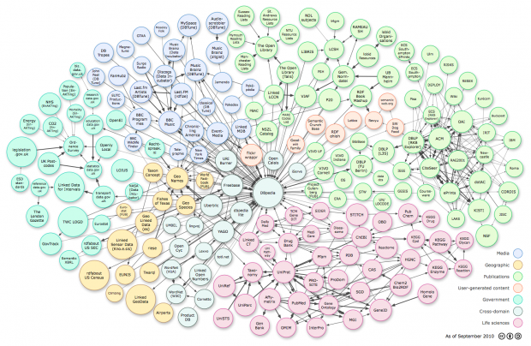
Knowledge Graphs
A set of facts represented as triplets
(head entity, relation, tail entity)
A variety of applications
Question answering
Search
Recommender Systems
Natural language understanding
…

Slide 3
Related Work on Knowledge Graph Embedding
Representing entities as embeddings
Representing relations as embeddings or matrices

Slide 4
Task: Knowledge Graph Completion
A fundamental task: predicting missing links
The Key Idea: model and infer the relation patterns in knowledge graphs according to observed knowledge facts.
The relationship between relations
Example:
Obama_Barack Wife Michelle_Obama
Parents of Parents are Grandparents
Michelle_Obama Husband Obama_Barack

Slide 5
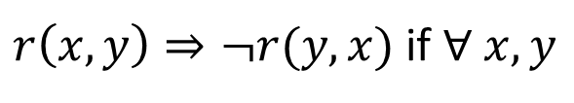
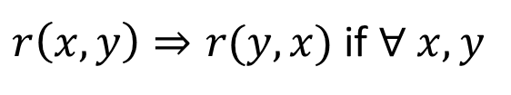
Relation Patterns
Symmetric/Antisymmetric Relations
Symmetric: e.g., Marriage
Antisymmetric: e.g., Filiation
Formally:
r is Symmetric:
$r\left(x,y\right)⇒r(y,x)$ if $∀ x, y$
r is Antisymmetric:
$r\left(x,y\right)⇒¬r(y,x)$ if $∀ x, y$

Slide 6
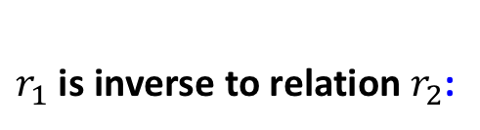
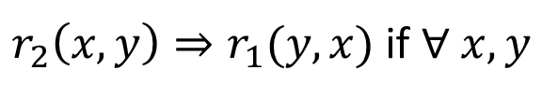
Relation Patterns
Inverse Relations
Husband and wife
Formally:
$r_{1}$ is inverse to relation $r_{2}$:
$r_{2}\left(x,y\right)⇒r_{1}(y,x)$ if $∀ x, y$

Slide 7
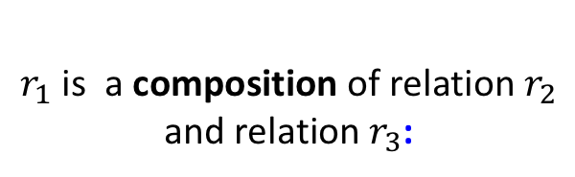
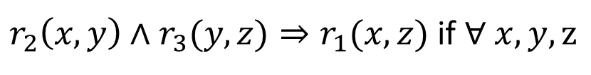
Relation Patterns
Composition Relations
My mother’s husband is my father
Formally:
$r_{1}$ is a composition of relation $r_{2}$
and relation $r_{3}$:
$r_{2}\left(x,y\right)∧r_{3}(y,z)⇒r_{1}(x,z)$ if $∀ x, y, z$

Slide 8
Abilities in Inferring the Relation Patterns
None of existing methods are able to model and infer all the three types of relation patterns

Slide 9
RotatE (Sun et al. ICLR’2019)
A new knowledge graph embedding model RotatE
Each relation as a elementwise rotation from the source entity to the target entity in the complex vector space
RotatE is able to model and infer all the three types of relation patterns
An efficient and effective negative sampling algorithm for optimizing RotatE
State-of-the-art results on all the benchmarks for link prediction on knowledge graphs
Zhiqing Sun, Zhihong Deng, Jian-Yun Nie, and Jian Tang. “RotatE: Knowledge Graph Embedding by Relational
Rotation in Complex Space.” To appear in ICLR’19.

Slide 10
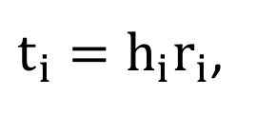
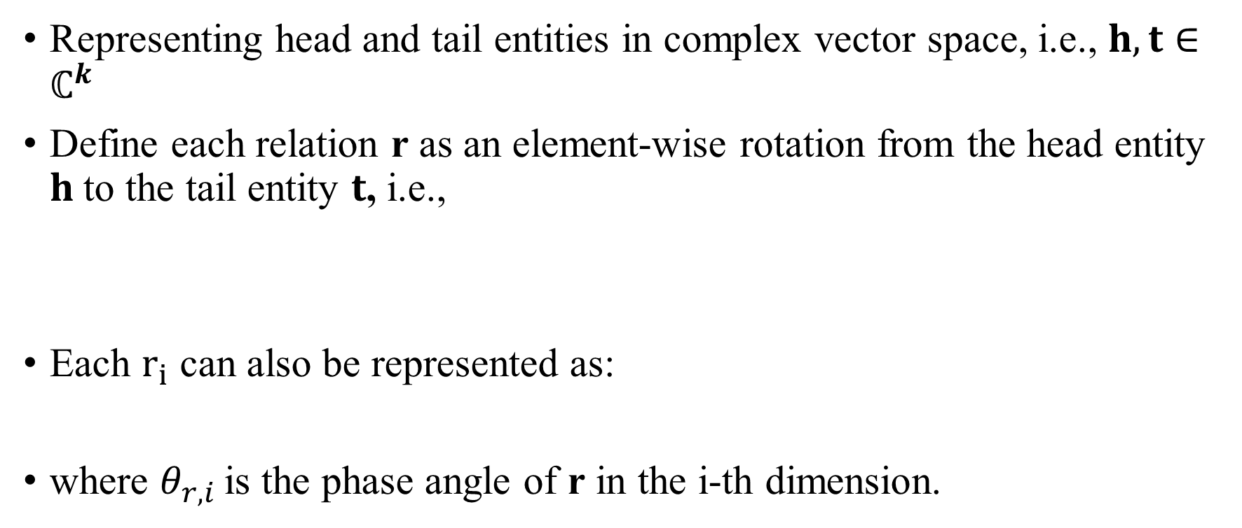
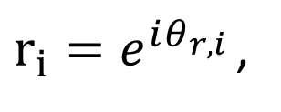
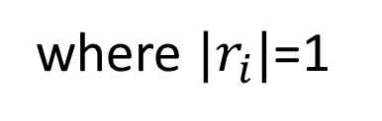
Relation as Elementwise Rotation in Complex Space
Representing head and tail entities in complex vector space, i.e., $h, t∈ℂ^{k}$
Define each relation r as an element-wise rotation from the head entity $h$to the tail entity $t$, i.e.,
Each $r_{i}$ can also be represented as:
where $θ_{r, i }$is the phase angle of r in the i-th dimension.
$t_{i}=h_{i}r_{i}$,
where $|r_{i}|$=1
$r_{i}=e^{iθ_{r, i }}$,

Slide 11
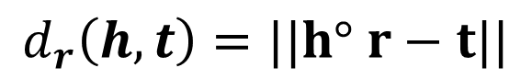
Geometric Interpretation
Define the distance function of RotatE as
$$d_{r}\left(h,t\right)=||h° r−t||$$

Slide 12
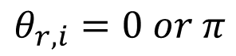
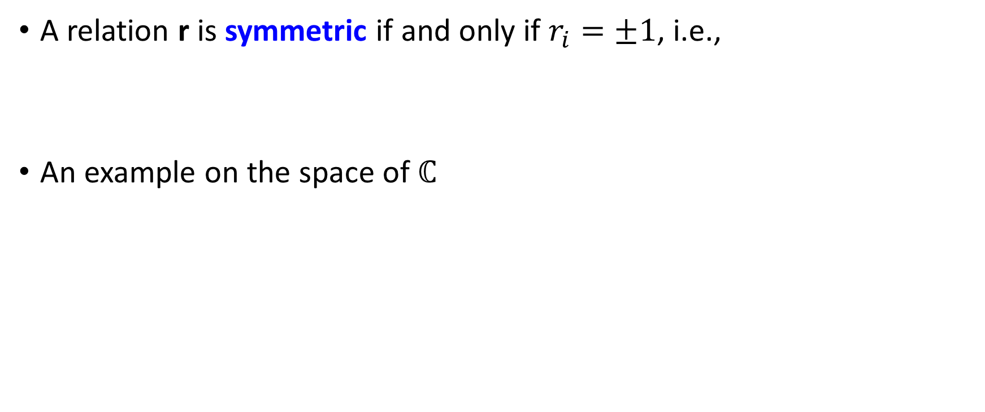
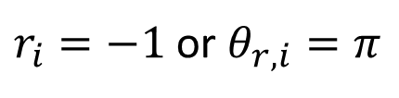
Modeling Symmetric and Antisymmetric
A relation r is symmetric if and only if $r_{i}=±1$, i.e.,
An example on the space of $ℂ$
$$θ_{r,i}=0 or π$$
$r_{i}=−1$ or $θ_{r,i}=π$

Slide 13
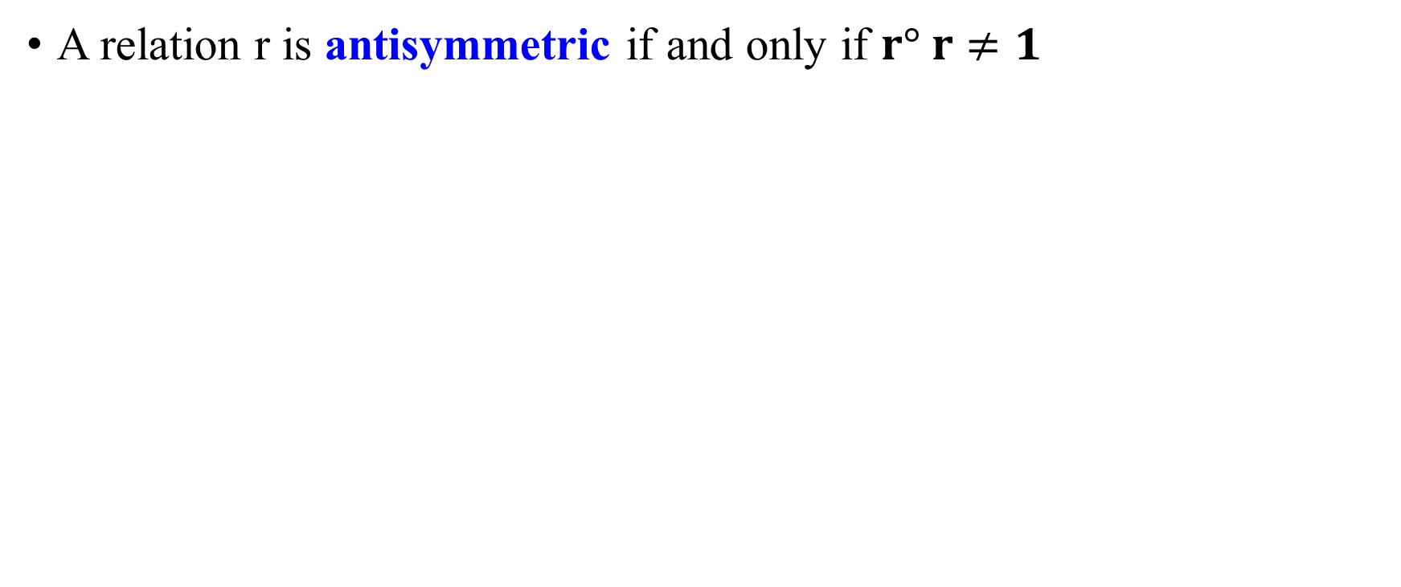
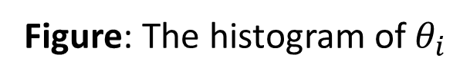
Modeling Symmetric and Antisymmetric
A relation r is antisymmetric if and only if $r° r≠1$
A symmetric relation
A antisymmetric relation
Figure: The histogram of$θ_{i }$

Slide 14
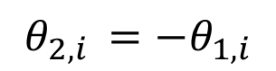
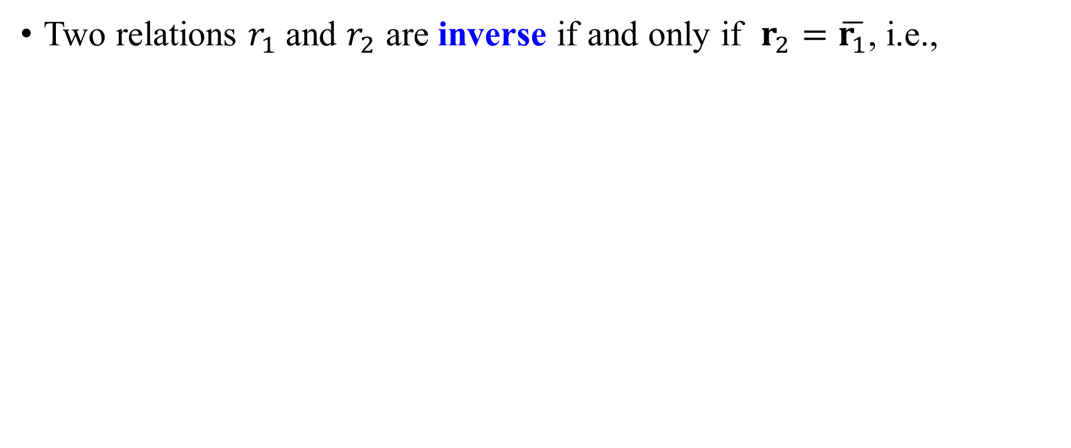
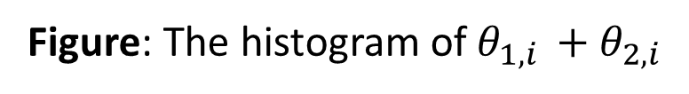
Modeling the Inverse Relations
Two relations $r_{1}$ and $r_{2}$ are inverse if and only if $r_{2}=\overline{r_{1}}$, i.e.,
$$θ_{2,i }=−θ_{1, i}$$
hypernym is the inverse relation of hyponym
Figure: The histogram of$θ_{1, i }+θ_{2,i }$

Slide 15
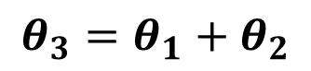
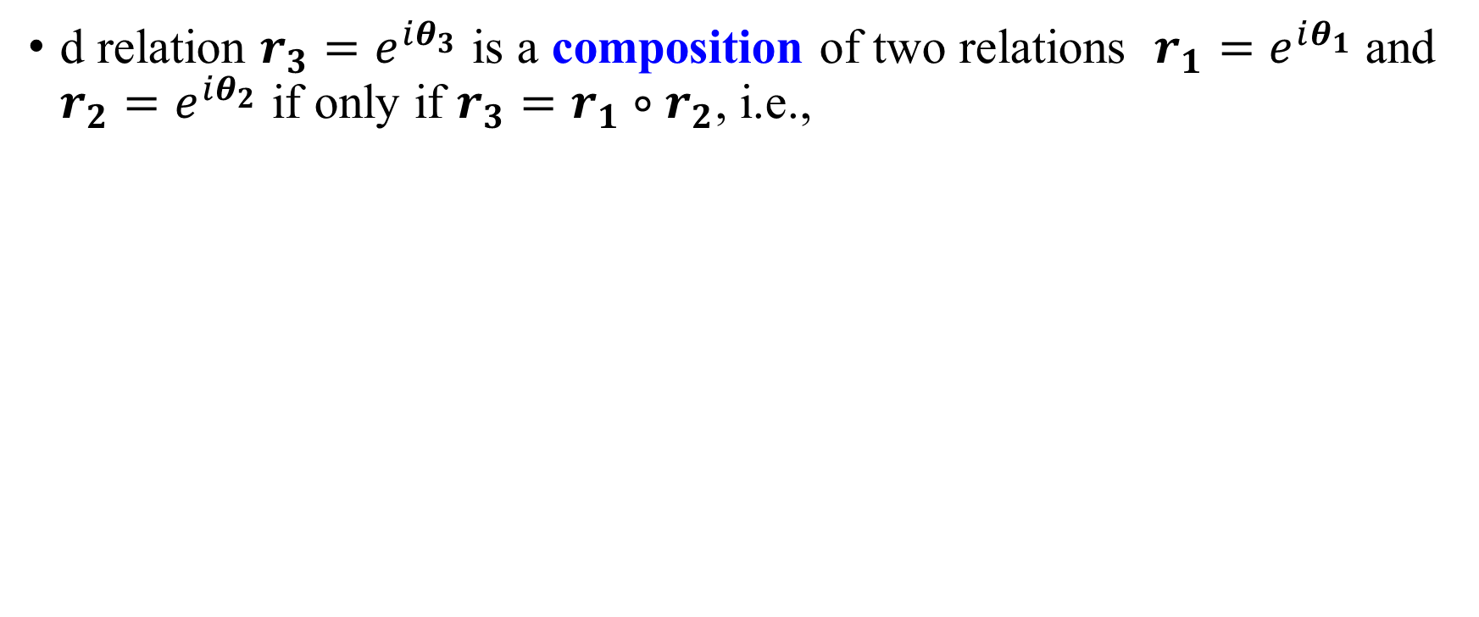
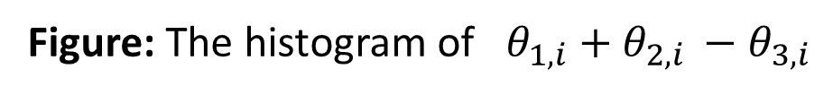
Modeling the Composition Relations
d relation $r_{3}=e^{iθ_{3}}$ is a composition of two relations $r_{1}=e^{iθ_{1}}$ and $r_{2}=e^{iθ_{2}}$ if only if $r_{3}=r_{1}∘r_{2}$, i.e.,
$$θ_{3}=θ_{1}+θ_{2}$$
Figure: The histogram of $θ_{1,i}+θ_{2,i }−θ_{3,i}$

Slide 16
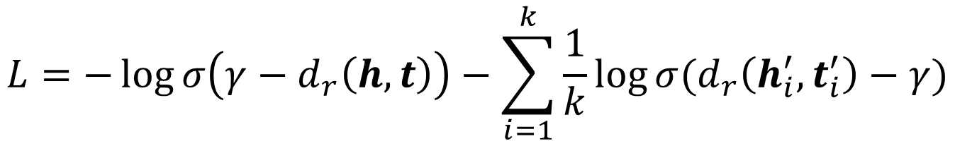
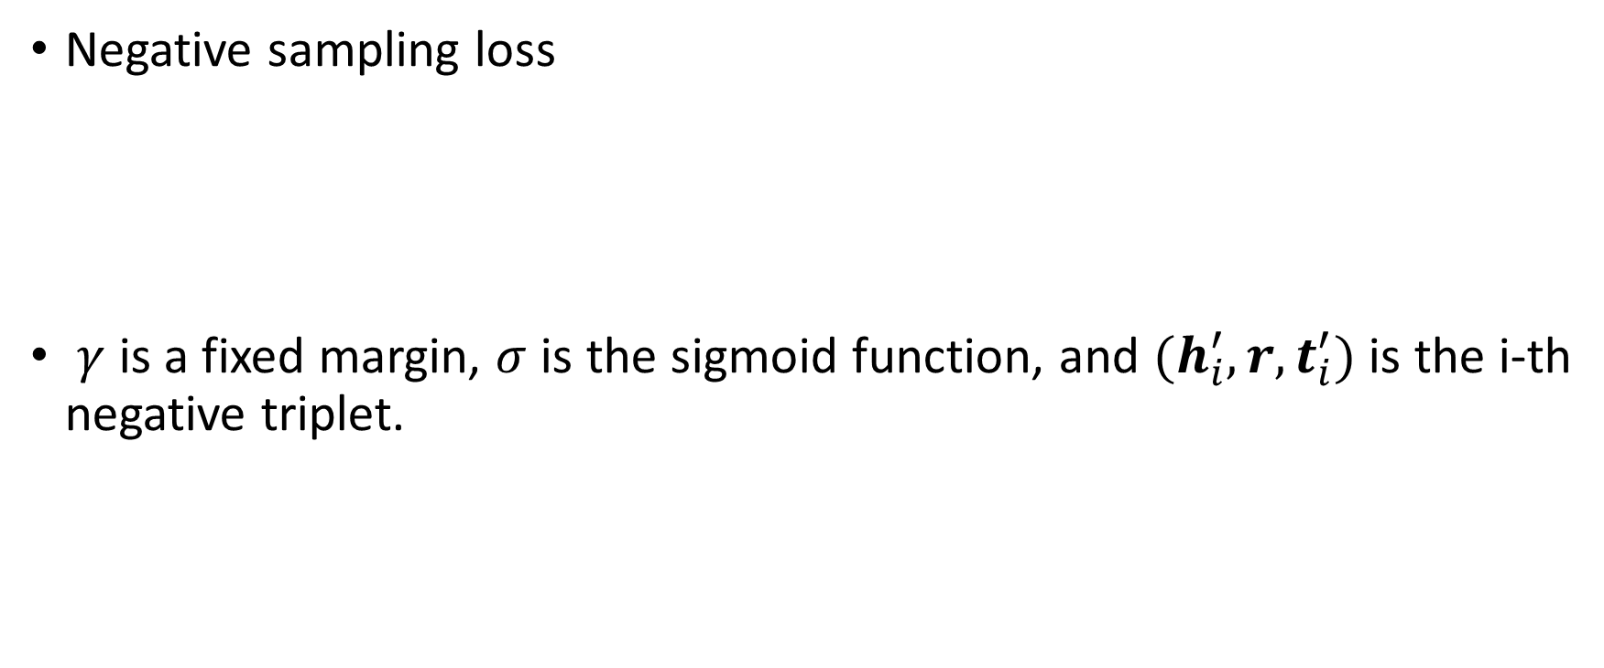
Optimization
Negative sampling loss
$γ$ is a fixed margin, $σ$ is the sigmoid function, and $(h_{i}^{′}, r, t_{i}^{′})$ is the i-th negative triplet.
$$L=−\log{σ\left(γ−d_{r}\left(h,t\right)\right)−\sum_{i=1}^{k}{\frac{1}{k}\log{σ(d_{r}\left(h_{i}^{′},t_{i}^{′}\right)−γ)}}}$$

Slide 17
Self-adversarial Negative Sampling
Traditionally, the negative samples are drawn in an uniform way
Inefficient as training goes on since many samples are obviously false
Does not provide useful information
A self-adversarial negative sampling
Sample negative triplets according to the current embedding model
Starts from easier samples to more and more difficult samples
Curriculum Learning
$α$ is the temperature of sampling. $f_{r}(h_{j}^{′},t_{j}^{′})$ measures the salience of the triplet

Slide 18
The Final Objective
Instead of sampling, treating the sampling probabilities as weights.

Slide 19
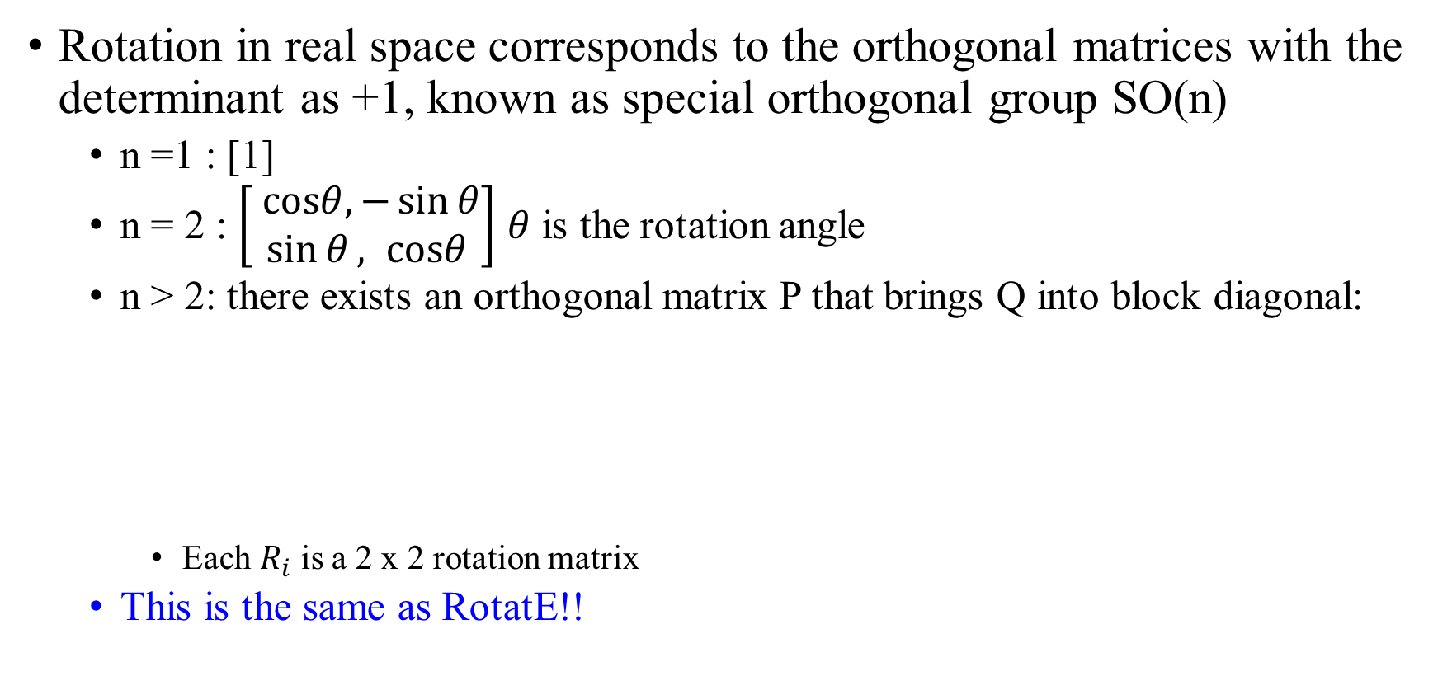
Connections to Rotation in Real Space
Rotation in real space corresponds to the orthogonal matrices with the determinant as +1, known as special orthogonal group SO(n)
n =1 : [1]
n = 2 : $\left[\begin{aligned} cosθ, −\sin{θ} \\ \sin{θ}, cosθ\end{aligned}\right]$ $θ$ is the rotation angle
n > 2: there exists an orthogonal matrix P that brings Q into block diagonal:
Each $R_{i}$ is a 2 x 2 rotation matrix
This is the same as RotatE!!

Slide 20
Experimental Results on FB15K and WN18
Task: Link prediction, (h, r, ?) or (?, r, t)
RotatE achieves state-of-the-art performance

Slide 21
Results on FB15k-237 and WN18RR
RotatE achieves state-of-the-art performance

Slide 22
Further Experiments
Comparing with the other models trained with self-adversarial
Similar results are observed

Slide 23
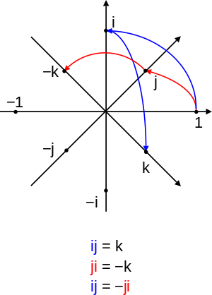
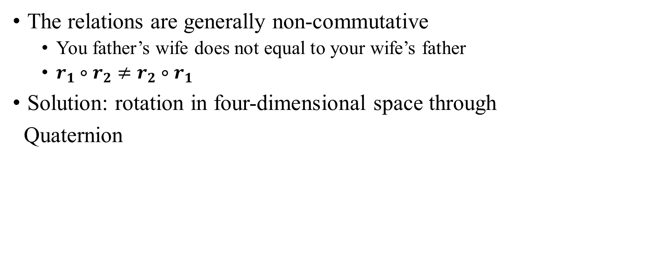
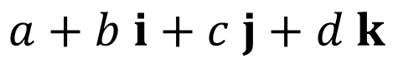
Limitations
The relations are generally non-commutative
You father’s wife does not equal to your wife’s father
$r_{1}∘r_{2}≠r_{2}∘r_{1}$
Solution: rotation in four-dimensional space through
Quaternion
$$a+b i+c j+d k$$

Slide 24
Summary
Modeling relation patterns is critical for knowledge base completion
Symmetric/Antisymmetric, Inverse, and composition
RotatE: define each relation as a element-wise rotation from the head entity to the tail entity in the complex vector space
Capable of modeling and inferring all the three types of relation patterns
A new self-adversarial negative sampling approach
Sampling the negative samples according to current embeddings
Curriculum learning
State-of-the-art results on all existing benchmark data sets

Slide 25
Knowledge Graph Alignment

Slide 26
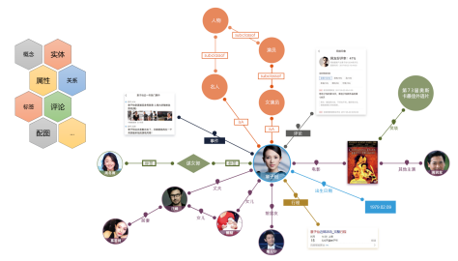
Multiple Knowledge Graphs Exists
Many different knowledge graphs
From different sources, of different languages
How to align entities and relations across two knowledge graphs?

Slide 27
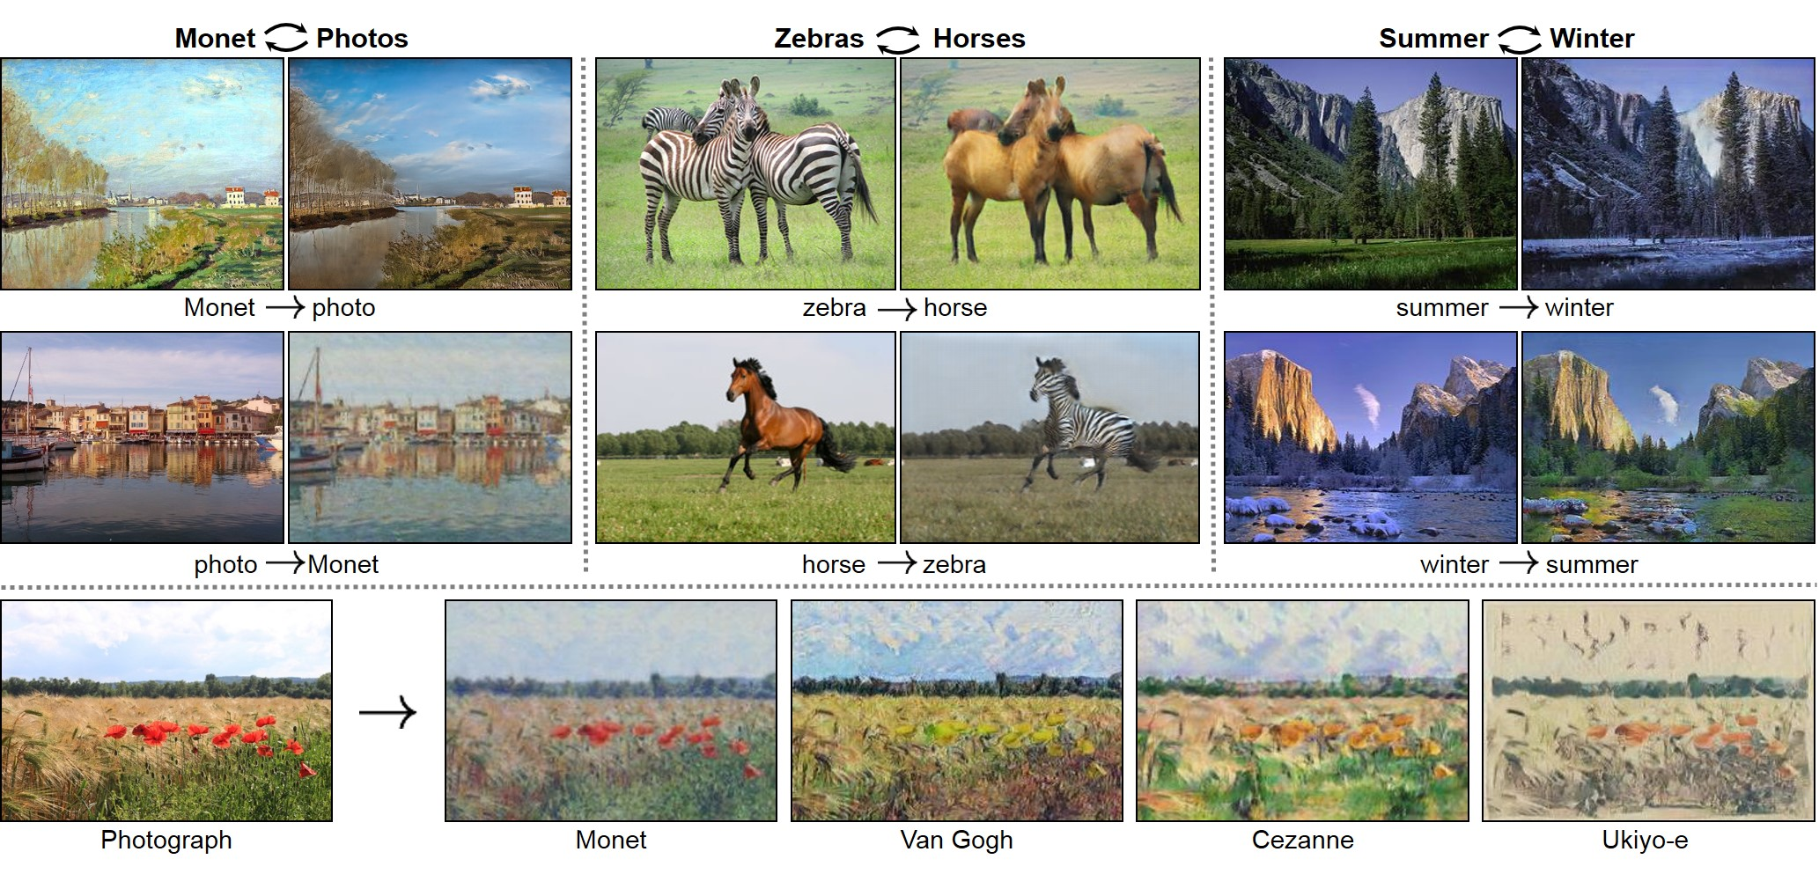
Related Work: Unsupervised Domain Alignment
Image translation: CycleGAN (Zhu et al. 2017)

Slide 28
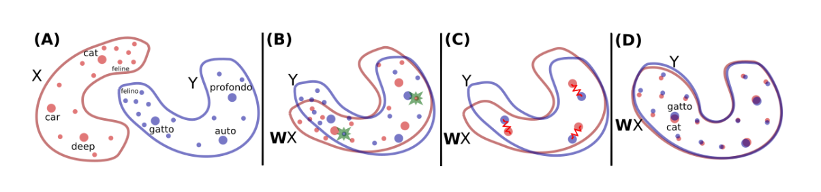
Related Work: Unsupervised Domain Alignment
Cross-Lingual word alignment based on word embeddings (Conneau et al. 2018):
Aim to learn a rotation matrix W from Domain X to Domain Y
Adversarial loss to distinguish the data from domain Y and the data mapped from X

Slide 29
Unsupervised Knowledge Graph Alignment (Qu et al. 2018)
First train the entity and relation embeddings based on existing knowledge graph embeddings
E.g., TransE and RotatE
Define an entity and relation mapping function
Meng Qu, Jian Tang and Yoshua Bengio. “Weakly-supervised Knowledge Graph Alignment with Adversarial Learning”. In submission.

Slide 30
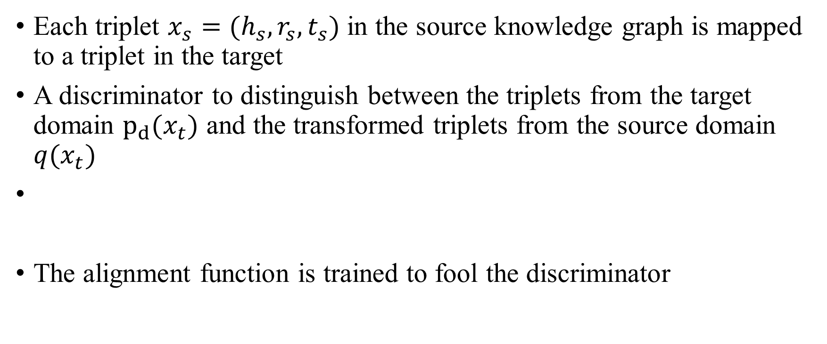
A Discrete GAN framework
Each triplet $x_{s}=(h_{s},r_{s},t_{s})$ in the source knowledge graph is mapped to a triplet in the target
A discriminator to distinguish between the triplets from the target domain $p_{d}(x_{t})$ and the transformed triplets from the source domain $q(x_{t})$
The alignment function is trained to fool the discriminator

Slide 31
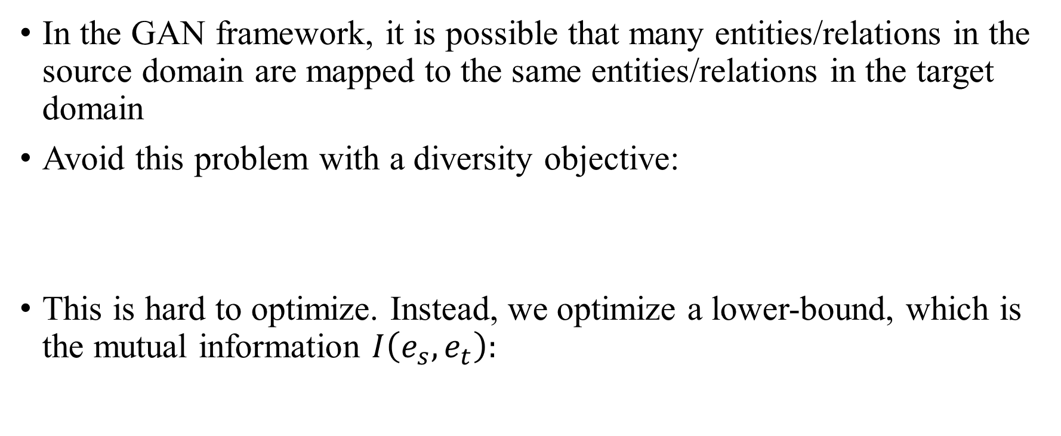
Dealing with Mode Collapse
In the GAN framework, it is possible that many entities/relations in the source domain are mapped to the same entities/relations in the target domain
Avoid this problem with a diversity objective:
This is hard to optimize. Instead, we optimize a lower-bound, which is the mutual information $I\left(e_{s},e_{t}\right):$
$$𝔼_{e_{s,u}, e_{s,v}\sim p_{d}(e_{s})}\left[KL\left(p_{θ}\left(e_{t} | e_{s,u}\right),p_{θ}\left(e_{t} | e_{s,v}\right)\right)\right]$$
$$𝔼_{e_{s,u}, e_{s,v}\sim p_{d}(e_{s})}\left[KL\left(p_{θ}\left(e_{t} | e_{s,u}\right),p_{θ}\left(e_{t} | e_{s,v}\right)\right)\right]≥I\left(e_{s},e_{t}\right)$$

Slide 32
Experimental Results
Entity alignment
UWT: word embedding alignment (Conneau et al. 2018)
KAGAN: our method

Slide 33
Weakly-supervised Entity Alignment
With few-labeled pairs, we are able to outperform the supervised methods

Slide 34
GraphVite: A Specific Graph Representation Learning System (Zhu et al. WWW’19)
Existing deep learning system
Mainly for images, text, and speech
Not suitable for graphs
GraphVite
A specific system designed for graphs
Take only one minute for a graph with one-million nodes
Zhaocheng Zhu, Shizhen Xu, Meng Qu, Jian Tang. “GraphVite: A High-Performance CPU-GPU Hybrid System for Node Embedding”. WWW’19.

Slide 35
Thanks! Contact: jian.tang@hec.ca

Slide 36
Knowledge Graph Embedding and Alignment
A variety of applications
Question answering
Search
Recommender Systems
…
Knowledge graph embedding (Sun et al. ICLR’19)
Zhiqing Sun, Zhihong Deng, Jian-Yun Nie, and Jian Tang. “RotatE: Knowledge Graph Embedding by RelationalRotation in Complex Space.” To appear in ICLR’19.
How to align the entities and relations across multiple knowledge graphs? (Qu et al. 2019)
Meng Qu, Jian Tang and Yoshua Bengio. “Weakly-supervised Knowledge Graph Alignment with Adversarial Learning”. In submission.

